Slide 1
Sentimental analysis natural language processing
Opinion mining

Slide 2
contents
Abstract
Existing system
Proposed system
Description
Diagrams
Coding
Output screens
Conclusion

Slide 3
Abstract
Sentiment analysis is a technique used to determine the emotional tone of a piece of text. It is often used to analyze customer feedback, social media posts, and other forms of text data. This project presents a simple sentiment analysis system that can be used to classify emails as positive or negative. The system uses a machine learning algorithm to learn from a dataset of labeled emails. Once the algorithm is trained, it can be used to classify new emails.

Slide 4
Existing system
There are a number of existing sentiment analysis systems available. However, many of these systems are complex and difficult to use. The proposed system is designed to be simple and easy to use. It can be used by anyone with a basic understanding of machine learning

Slide 5
Proposed system
The proposed system consists of the following components:
A dataset of labeled emails
A machine learning algorithm
A user interface
The dataset of labeled emails is used to train the machine learning algorithm. The machine learning algorithm is then used to classify new emails. The user interface allows the user to enter an email and receive a classification.

Slide 6
Description
This project presents a simple sentiment analysis system that can be used to classify emails as positive or negative. The system uses a machine learning algorithm to learn from a dataset of labeled emails. Once the algorithm is trained, it can be used to classify new emails.
The system is designed to be simple and easy to use. It can be used by anyone with a basic understanding of machine learning.

Slide 7
The system has a number of potential applications.
It can be used to:
Analyze customer feedback to identify areas for improvement
Monitor social media sentiment to track brand reputation
Filter emails to identify important messages

Slide 8
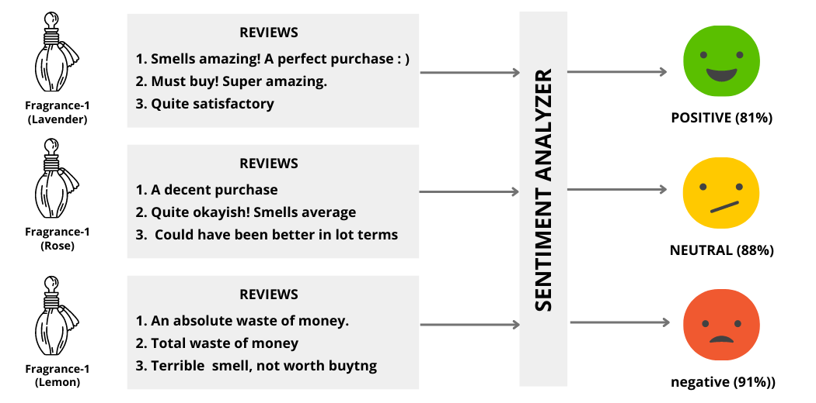
Diagrams

Slide 9
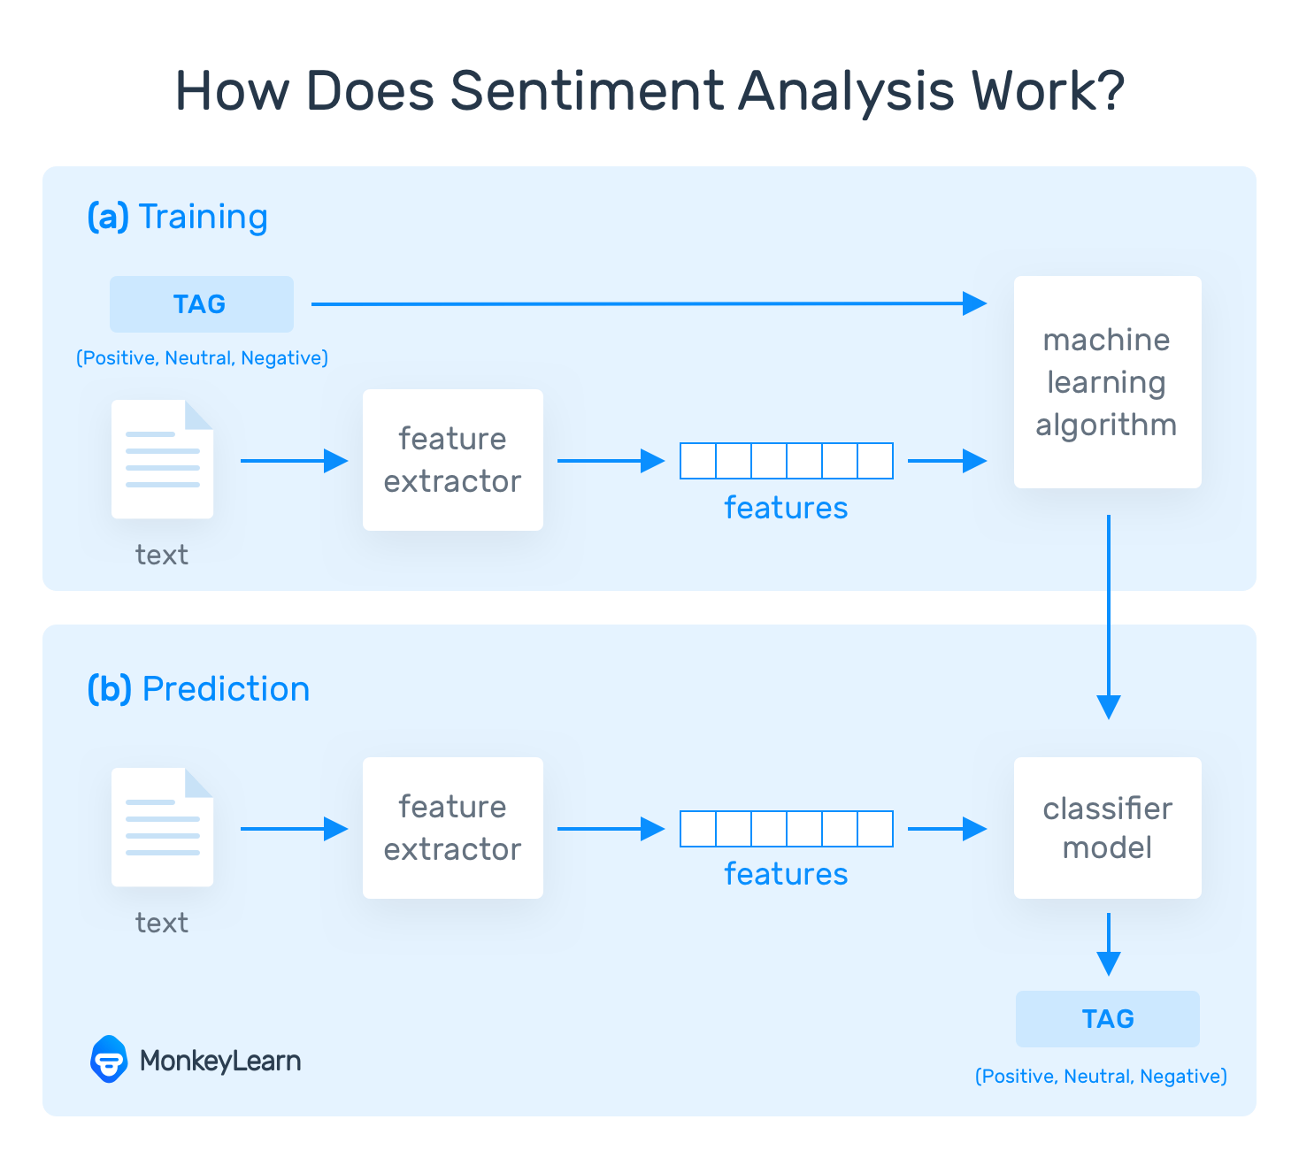

Slide 10
Coding
import pandas as pd
from sklearn.feature_extraction.text import TfidfVectorizer
from sklearn.linear_model import LogisticRegression
from sklearn.model_selection import train_test_split
from sklearn.metrics import accuracy_score
# Load the dataset
emails = pd.read_csv('emails.csv')
# Preprocess the data
emails['text'] = emails['text'].str.lower()

Slide 11
emails['text'] = emails['text'].str.replace('[^\w\s]', '')
# Create the TF-IDF vectorizer
vectorizer = TfidfVectorizer()features = vectorizer.fit_transform(emails['text'])
# Split the data into training and testing sets
X_train, X_test, y_train, y_test = train_test_split(features, emails['sentiment'], test_size=0.2)
# Train the logistic regression model
model = LogisticRegression()model.fit(X_train, y_train)
# Evaluate the model on the test set
predictions = model.predict(X_test)
accuracy = accuracy_score(y_test, predictions)
print("The accuracy of the model is:", accuracy)

Slide 12
output
The following output screens show the results of the sentiment analysis system:
Positive Email: The following output screen shows a positive email that has been classified by the system.
Negative Email: The following output screen shows a negative email that has been classified by the system.

Slide 13
Conclusion
The proposed system is a simple and easy-to-use sentiment analysis system. It can be used to classify emails as positive or negative. The system is based on a machine learning algorithm that is trained on a dataset of labeled emails.

Slide 14
THANK YOU

